Slide 1

Implementing and Interfacing with KVM
Cristian Palomo-Ramirez
cpalomo-ramirez@csumb.edu
Ben Ryan
bpryan@email.wm.edu
HPC Cluster Engineering Academy
Mentor: Dave Fox
Notes:
We should introduce ourselves, our schools, our majors, our years, etc. We could also create a separate slide for this stuff if we want to.

Slide 2
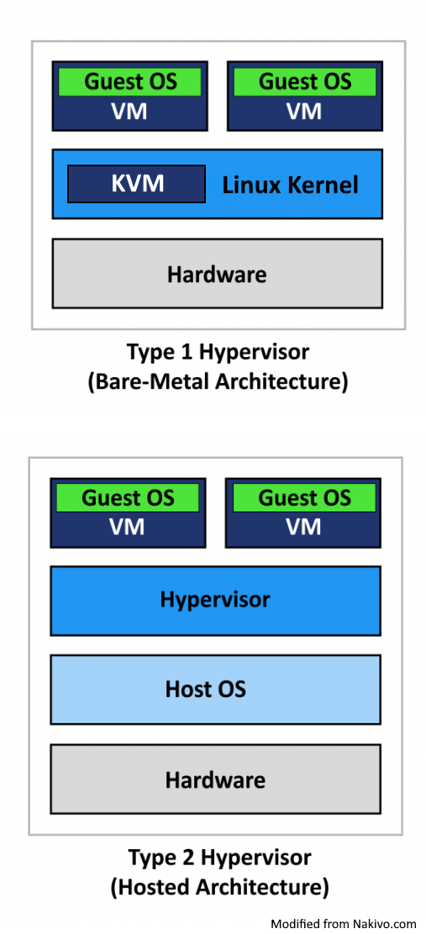
What is KVM and why is it useful?
A Kernel-based Virtual Machine (KVM) is a type of VM that turns the Linux kernel into a bare-metal hypervisor.
KVM allows the host machine to treat every guest (VM) as if it were a Linux process.
Some of the benefits of a bare-metal VM are efficient usage of resources for smaller, specialized tasks, ease of testing, etc.
The main benefits of KVM specifically is that it is built into Linux and is extremely efficient.
Notes:
A hypervisor is hardware or software that separates a computer's physical hardware from the OS to allow for creation of virtual machines. There are two types. A hypervisor is considered "bare metal" when it runs directly on the hardware, as opposed to a hosted hypervisor (such as VMware) which runs on the OS like any other program.
KVM allows the host machine to treat every guest (VM) as if it were a Linux process, which means that every VM has the same level of access to physical hardware as another other process and can easily and efficiently be used thanks to tools that Linux already has built in, such as the scheduler.
Some of the benefits of a bare-metal VM are efficient usage of resources for smaller, specialized tasks, ease of testing configurations prior to deployment, and less need for physical hardware.
The main benefits of KVM specifically is that it is built into Linux and is extremely efficient considering that the Linux kernel acts as the hypervisor and has inherently unrestricted access to the hardware and many tools that the VM can utilize natively, as any other process. Its also useful because it provides features for enhanced security, scaling, and uninterrupted host migration.

Slide 3
Implementation and Tools
Virt-manager is a GUI tool commonly used to manage KVM guests
libvirt is the tool/package for managing guests via the command line
Installing a variety of Linux distributions manually on individual guests is time consuming.
Using tools such as BASH scripting and Ansible can automate this process.
Kickstart allows for pre-configuration of the operating system prior to installation.
Notes:
KVM comes built into linux.
Virt-manager is the standard method of implementing KVM guests, either with a GUI or on the command line.
Installing a variety of Linux distributions manually on individual guests is time consuming and error-prone, even when using the command line.
Using tools such as simple BASH scripting and Ansible can automate the process of basic installation for any VM.
Kickstart (or non-CentOS/RHEL equivalents) allows for pre-configuration of the operating system prior to installation on a guest, eliminating the need for user input and further automating and accelerating the process.

Slide 4
Results
Guest implementation of various Linux distros
Required packages
Test user with sudo privileges
Automated installation
Documentation for future admin use/maintenance
Plans for future:
Set up a guest with TOSS
Set up environments for testing MSR-safe kernel modules
Respond to Gitlab Continuous Integration requests
script/tool to run the CI request on the allocated image
capture results/logs
deallocate/clean up instance
Notes:
Coordinating with Barry Rountree to create a test environment for MSR safe kernel modules. These VMs are to be implemented to Barry's specifications in order to meet the needs of his testing environment. He would like multiple kernels for each Linux distribution installed with kernel headers and packages necessary for building the kernel modules. He also would like a test user account to be set up with privileges needed to load/unload these kernel modules and edit the ownershipof files.
for files in
/dev/cpu.
Some of the Linux distributions we are working with are CentOS 7 and 8, Debian 9, Ubuntu 18.04 and 20.04, OpenSUSE 15.2, and TOSS.

Slide 5
Disclaimer
This document was prepared as an account of work sponsored by an agency of the United States government. Neither the United States government nor Lawrence Livermore National Security, LLC, nor any of their employees makes any warranty, expressed or implied, or assumes any legal liability or responsibility for the accuracy, completeness, or usefulness of any information, apparatus, product, or process disclosed, or represents that its use would not infringe privately owned rights. Reference herein to any specific commercial product, process, or service by trade name, trademark, manufacturer, or otherwise does not necessarily constitute or imply its endorsement, recommendation, or favoring by the United States government or Lawrence Livermore National Security, LLC. The views and opinions of authors expressed herein do not necessarily state or reflect those of the United States government or Lawrence Livermore National Security, LLC, and shall not be used for advertising or product endorsement purposes.

